Slide 1


Slide 2
Strings, Structs & Memory Segments
What’s Really Going On In C

Slide 3
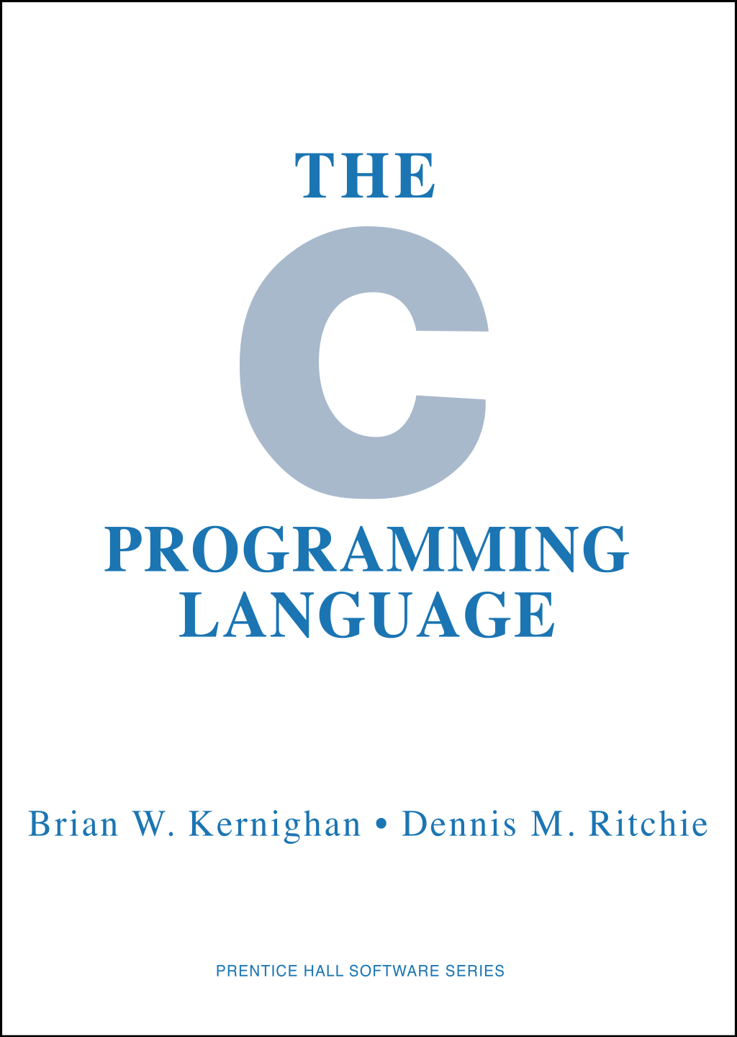
Last Lecture
In the last lecture we talked about the various memory segments of C
Each has its own behavior and requirements for use
Often things that look the same will act differently
Pointers to stuff, in particular: which segment is the pointer pointing to?
Notes:
Can be found online… but I can’t link to it

Slide 4
The C Mental Model
You can think of C programs as being along the lines of programs in the LMSM: a giant array of bytes in memory
Like on the LMSM, C programs have different segments of memory used for different things
Notes:
Can be found online… but I can’t link to it

Slide 5
The C Mental Model
The “code” segment (aka Text Segment) - the instructions of the program are stored here, typically read only
Corresponds to the low memory locations in the LMSM
Notes:
Can be found online… but I can’t link to it

Slide 6
The C Mental Model
The Data & BSS segments - global and static variables are stored here
Known, fixed size
BSS is zero initialized
Similar to the area just after a LMSM program where we stored constants
Notes:
Can be found online… but I can’t link to it

Slide 7
Memory Segments In C
C has different segments of memory
The Stack - where function parameters, local variables and other function related information is stored
The Heap - an area where dynamically allocated memory lives
Notes:
Can be found online… but I can’t link to it

Slide 8
Memory Segments In C
The Stack - where function parameters, local variables and other function related information is stored
Similar to the upper memory location in the LMSM, where the stack pointer register points to
Notes:
Can be found online… but I can’t link to it

Slide 9
Memory Segments In C
The Heap - an area where dynamically allocated memory lives
Similar to our use of the the higher 100s in the LMSM to store temporary runtime data
Notes:
Can be found online… but I can’t link to it

Slide 10
Memory Segments In C
These four segments of memory make up the core content of a C program
Memory in C is byte-addressed
If you have an address in a register it points to a given byte in memory
Notes:
Can be found online… but I can’t link to it

Slide 11
Strings & Structs
Understanding these segments is particularly important when dealing with two type of data in C:
Strings
Structs
These two types of data tend to make up the majority of most real world applications
Notes:
Can be found online… but I can’t link to it

Slide 12
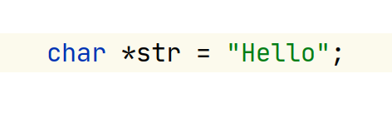
Strings
Beginning with string: in C Strings are very raw and low level
They are, in reality, just a one-dimensional array of characters, terminated by a null (zero) character
Each character is 8 bits
aka 1 byte
Notes:
Can be found online… but I can’t link to it

Slide 13
Strings
Here we have a five character string (sometimes called a “C String”)
These characters will be laid out in successive memory locations, just like an array
[‘h’, ‘e’, ‘l’, ‘l’, ‘o’]
Notes:
Can be found online… but I can’t link to it

Slide 14
Strings
Actually, I’m lying, there are six characters in this string
Why?
Notes:
Can be found online… but I can’t link to it

Slide 15
Strings
Actually, I’m lying, there are six characters in this string
Why?
A hidden null or, literally, the value 0 (zero) terminate the string
Notes:
Can be found online… but I can’t link to it

Slide 16
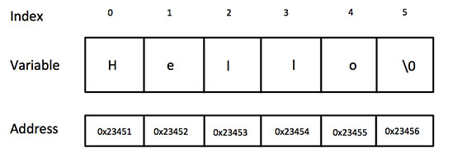
Strings
Actuallythere are six characters in this string
Why?
A hidden null or, literally, the value 0 (zero) terminate the string
Notes:
Can be found online… but I can’t link to it

Slide 17
Strings
A string literal in C returns a pointer to a char
What memory segment does this pointer point to?
Is this string mutable?
E.g. Can we change “H” to “J”, and make it “Jello”?
Notes:
Can be found online… but I can’t link to it

Slide 18
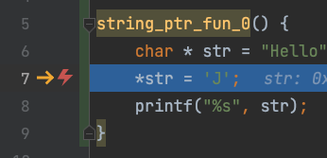
Strings
Nope, this string is living in the Data segment, so it is read only!
If we want to mutate this string, we need to make a copy of it somewhere mutable
The stack (kinda hard)
The heap (where you’d normally do this)
Notes:
Can be found online… but I can’t link to it

Slide 19
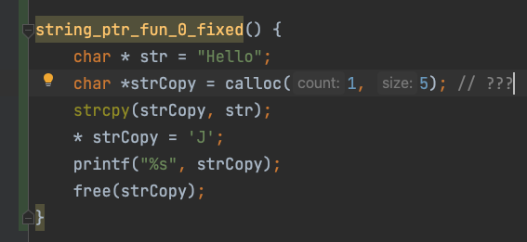
Strings
OK, so instead let’s use calloc() to allocate some memory on the heap, copy the string out to that, and then mutate it
Notes:
Can be found online… but I can’t link to it

Slide 20
Strings
Wait a sec, how long did we say that the string “Hello” is?
And we only allocated 5 bytes with calloc()
But it still worked?!?
Yep, C doesn’t care
It wrote right off the end of that memory segment you were allocated
Notes:
Can be found online… but I can’t link to it

Slide 21
Strings
This didn’t even cause an error
If something else had been living next to the memory location we allocated, this would have stomped right on its value in memory
C doesn’t care, worse is better
Notes:
Can be found online… but I can’t link to it

Slide 22
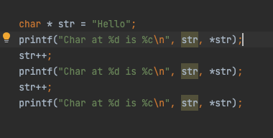
Strings & Pointers
Because strings in C are just pointers to chars, we can do pointer arithmetic on them
Here’s some code where we increment the initial pointer that points to the string in the BSS
Notes:
Can be found online… but I can’t link to it

Slide 23
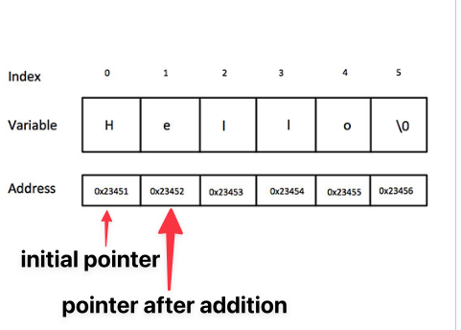
Strings & Pointers
The numeric value of the pointer here increases by one because the type of the pointer is char, which is 1 byte wide
If the pointer had, instead, been to a 4 byte integer, the value of the pointer would have increased by 4
Notes:
Can be found online… but I can’t link to it

Slide 24
Strings & Pointers
Again, pointers are just addresses to locations in memory that can be dereferenced to get at the actual underlying data value
Notes:
Can be found online… but I can’t link to it

Slide 25
Strings
Strings in C are very difficult to deal with
Easy to screw things up
Accidentally writing off the end of a char *
Accidentally handing out a char * reference to an immutable memory location
etc.
Notes:
Can be found online… but I can’t link to it

Slide 26
Strings
It’s hard to know how large a string is going to be in advance (e.g. user input)
Programming languages like Java provide abstractions like the String class, or the StringBuilder class, for easier manipulation/creation of strings
Notes:
Can be found online… but I can’t link to it

Slide 27
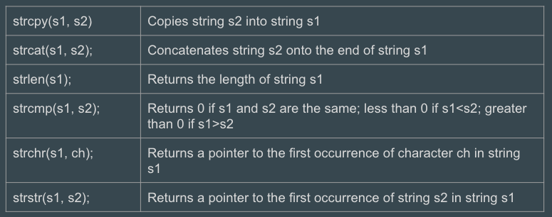
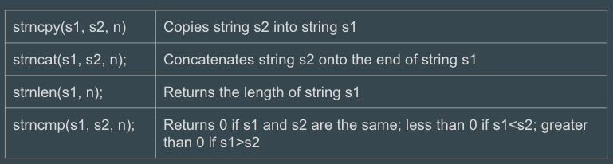
Strings
C, instead, provides functions for string manipulation in the string.h standard library
strcpy(), strcat(), etc
The safe versions of these functions start with strn and take an n, which is the max length to copy/index over in the first string
Notes:
Can be found online… but I can’t link to it

Slide 28
Strings
Broadly, these are a huge pain to work with when compared with strings in other languages
When I have to work with Strings in C, the first thing I do is create a small string library that hides all this away internally
I usually call it str_buf for String Buffer
Notes:
Can be found online… but I can’t link to it

Slide 29
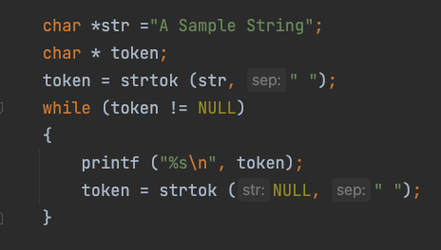
Strings
You are going to need to deal with C Strings in the next part of the project
In particular, you are going to need to tokenize assembly (that is, split it up into chunks of text based on whitespace)
Notes:
Can be found online… but I can’t link to it

Slide 30
Strings
The standard function for doing this is C is strtok()
The way it works is that you pass a string in to tokenize, plus a separator, and it returns a pointer to the first token
Notes:
Can be found online… but I can’t link to it

Slide 31
Strings
You can then get the next token by passing NULL into strtok, which tells it “Give me the next token of the last string you tokenized”
Horrible API!
Notes:
Can be found online… but I can’t link to it

Slide 32
Strings
strtok() keeps a global variable around pointing to the last string tokenized
Even worse, it mutates the original string passed into it, so this code actually segfaults!
We need to make a copy of the string to tokenize it
Notes:
Can be found online… but I can’t link to it

Slide 33
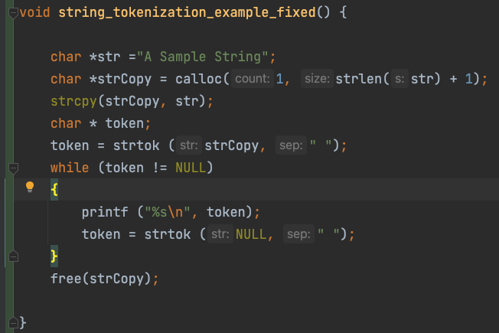
Strings
Here is the fixed code, again we need to copy the string literal out to somewhere in memory that is mutable
Of course here it is easy to know that str is immutable
But what if it was an argument?
Hard to know!
Best to make a copy defensively, right?
Notes:
Can be found online… but I can’t link to it

Slide 34
Strings
This is showing how C is hard: there are a lot of hidden gotchas and semantics that you need to keep straight
I think this is a great example where object oriented programming could hide a lot of complexity from the end user
Notes:
Can be found online… but I can’t link to it

Slide 35
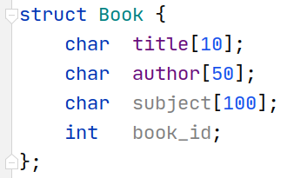
Structs
Moving on to Structs
Structs are the closest things to classes that C has, but they only hold data
It is actually possible to store function pointers in them, and some people emulate OO programming this way
Notes:
Can be found online… but I can’t link to it

Slide 36
Structs
Broadly, in large C programs, you have important structs as the first argument to a set of functions, often prefixed with the same name to make clear they all “belong together”
Again, I like OO programming, despite the bad name it has in some circles
Notes:
Can be found online… but I can’t link to it

Slide 37
Structs
Structs are defined with the struct keyword
If you do not create a typedef (Type Definition) for the struct as well, you have to include a struct keyword when you declare them too
Notes:
Can be found online… but I can’t link to it

Slide 38
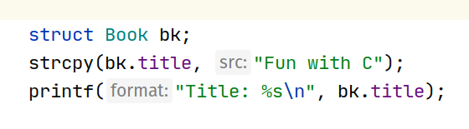
Structs
Structs are defined with the struct keyword
If you do not create a typedef (Type Definition) for the struct as well, you have to include a struct keyword when you declare them too
Notes:
Can be found online… but I can’t link to it

Slide 39
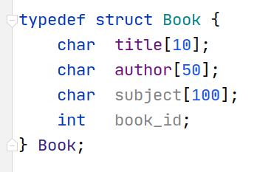
Structs
If you include a typedef with the struct definition, then you can declare things in a more natural manner
Notes:
Can be found online… but I can’t link to it

Slide 40
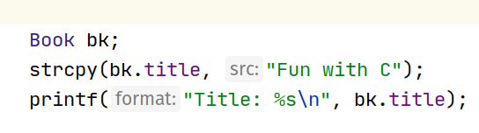
Structs
If you include a typedef with the struct definition, then you can declare things in a more natural manner
Notes:
Can be found online… but I can’t link to it

Slide 41
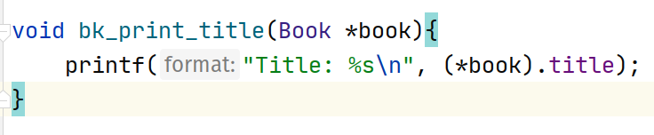
Structs
It is very common to pass around pointers to structs
To access a field on a pointer to a struct, you need to dereference the pointer, then use the dot (.) operator to reference a given field
Notes:
Can be found online… but I can’t link to it

Slide 42
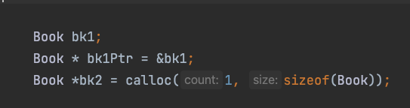
Structs
Note that structs can very easily be created on the stack
The first line allocates a book struct on the stack
The third line allocates a book struct on the heap
Note that C makes no distinction between pointers to these two memory locations
Notes:
Can be found online… but I can’t link to it

Slide 43
Structs
We could return either of these pointers from this function
Very dangerous if we return the first pointer!
In the second case, we have to determine who deallocates the struct!
C is hard
Notes:
Can be found online… but I can’t link to it

Slide 44
Structs
On the other hand, we could also pass these structs into functions
This is safe in both cases
The called function will live as long as the current function, so the stack data stays valid
Unless the called function stores the pointer out to a global value
C is hard
Notes:
Can be found online… but I can’t link to it

Slide 45
Structs
C calling conventions are pass by value
If you pass a struct (rather than a pointer to struct) into a function, it will make a whole copy of the struct
If you pass a pointer to a struct into a function, it will reference the original struct
Demo
Notes:
Can be found online… but I can’t link to it

Slide 46
Review
C strings are a sequence of byte-sized ASCII characters, terminated by a null (0) character
C strings are touchy and error prone
You are going to need to use C strings in the next checkpoint, along with strtok(). Sorry.
Structs provide a way to define simple data structures in C
Structs contain only data, they are not objects like you are used to in Python or Java

